Slide 1
CS 2001 Data Structures
Week 3
Lecture 1

Slide 2
Agenda
What is Recursion ?
Why is Recursion Important ? What are the resource requirements for recursion?
An Example program with function calls and recursion implementation? How are recursive functions different from normal non-recursive functions?
Stack Frame? Activation Records? Dynamic Link?
Anatomy of a Recursive Call,

Slide 3
What is recursion?
When a function calls itself to make the problem smaller.
A Base Case
Terminate all recursive calls
Clearly identifiable
A Recurrence
Progression

Slide 4
When should we use recursion?
Recursion is made for solving problems that can be broken down into smaller, repetitive problems. It is especially good for working on things that have many possible branches and are too complex for an iterative approach. One good example of this would be searching through a file system.

Slide 5
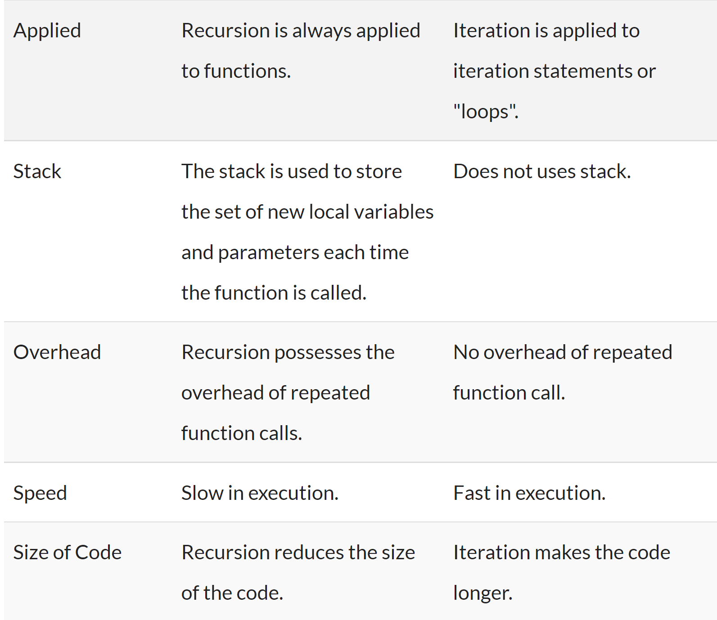
How are recursive functions different from normal non-recursive functions?

Slide 6
Working of recursion
Stack frame – our activation record
keeps the information about local variables, formal parameters, return address and all information passed to the caller function.

Slide 7
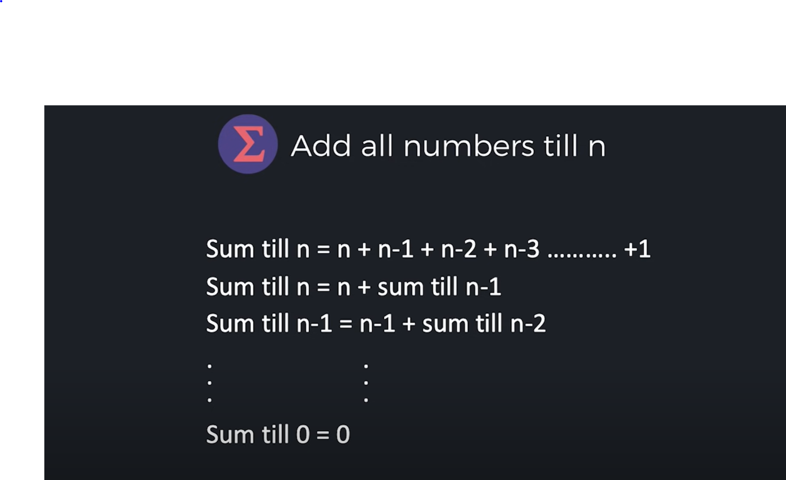
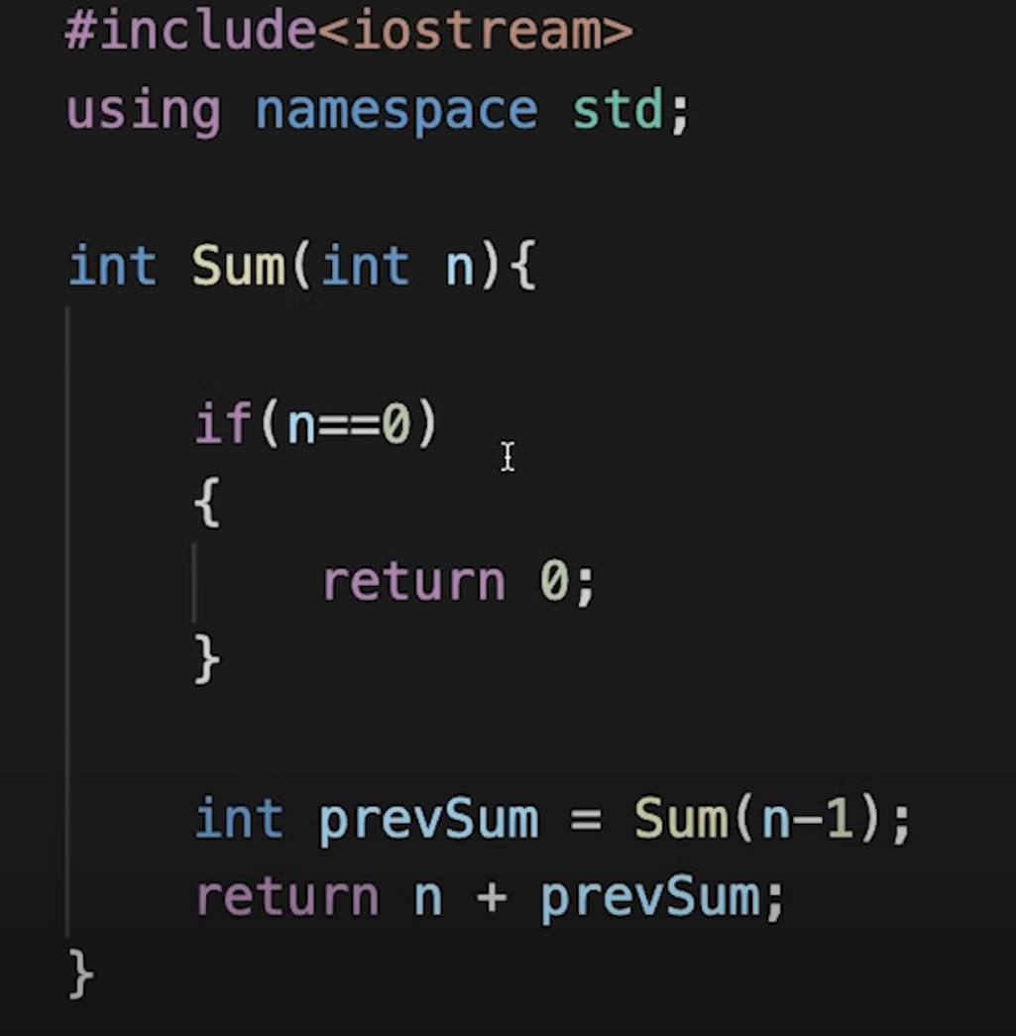

Slide 8
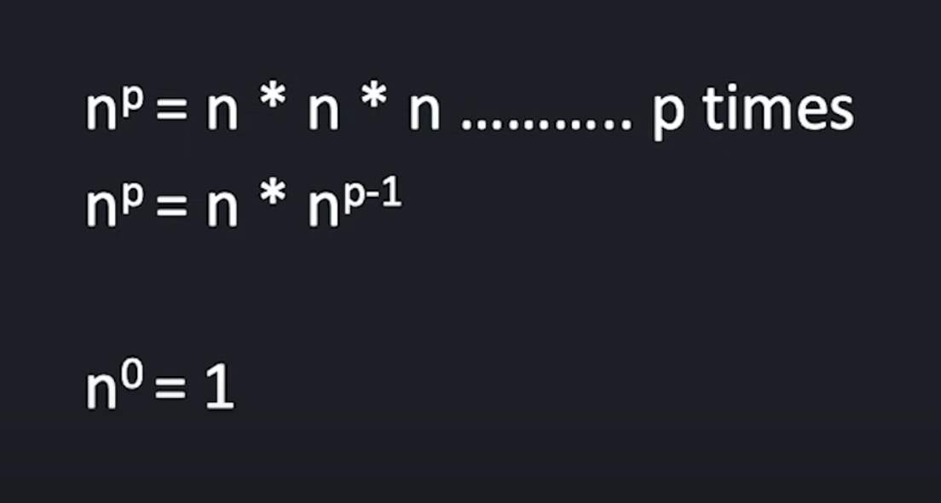
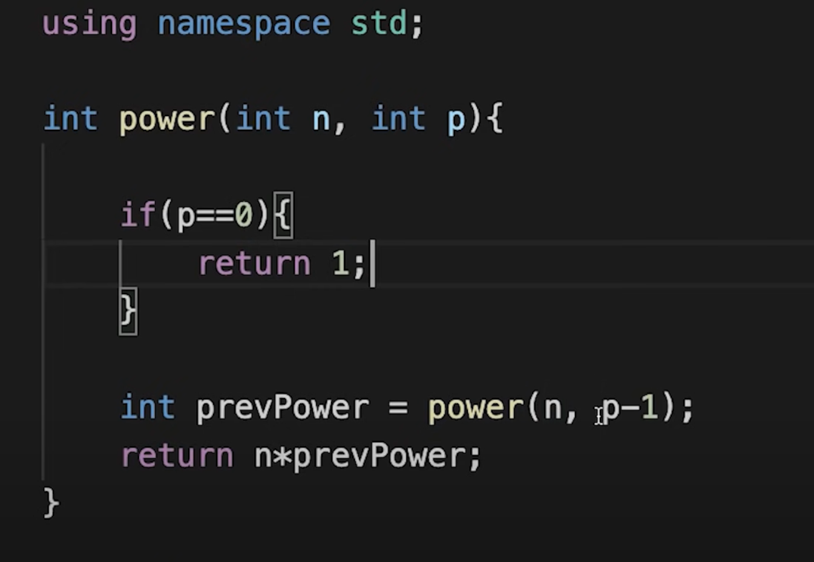
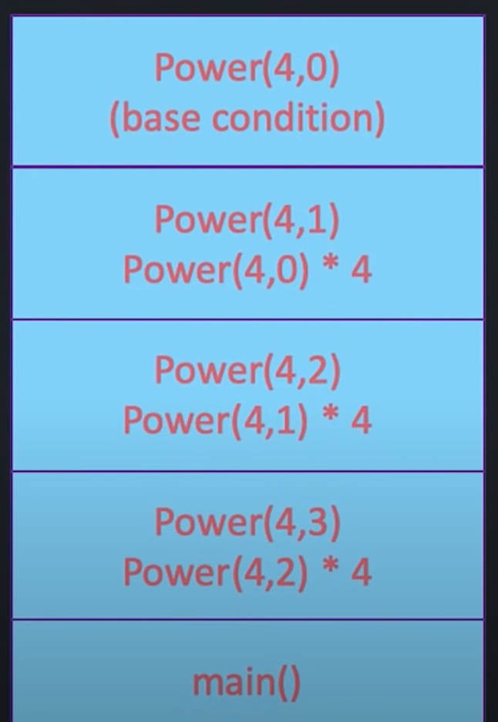
Calculate n raised to the power p.

Slide 9
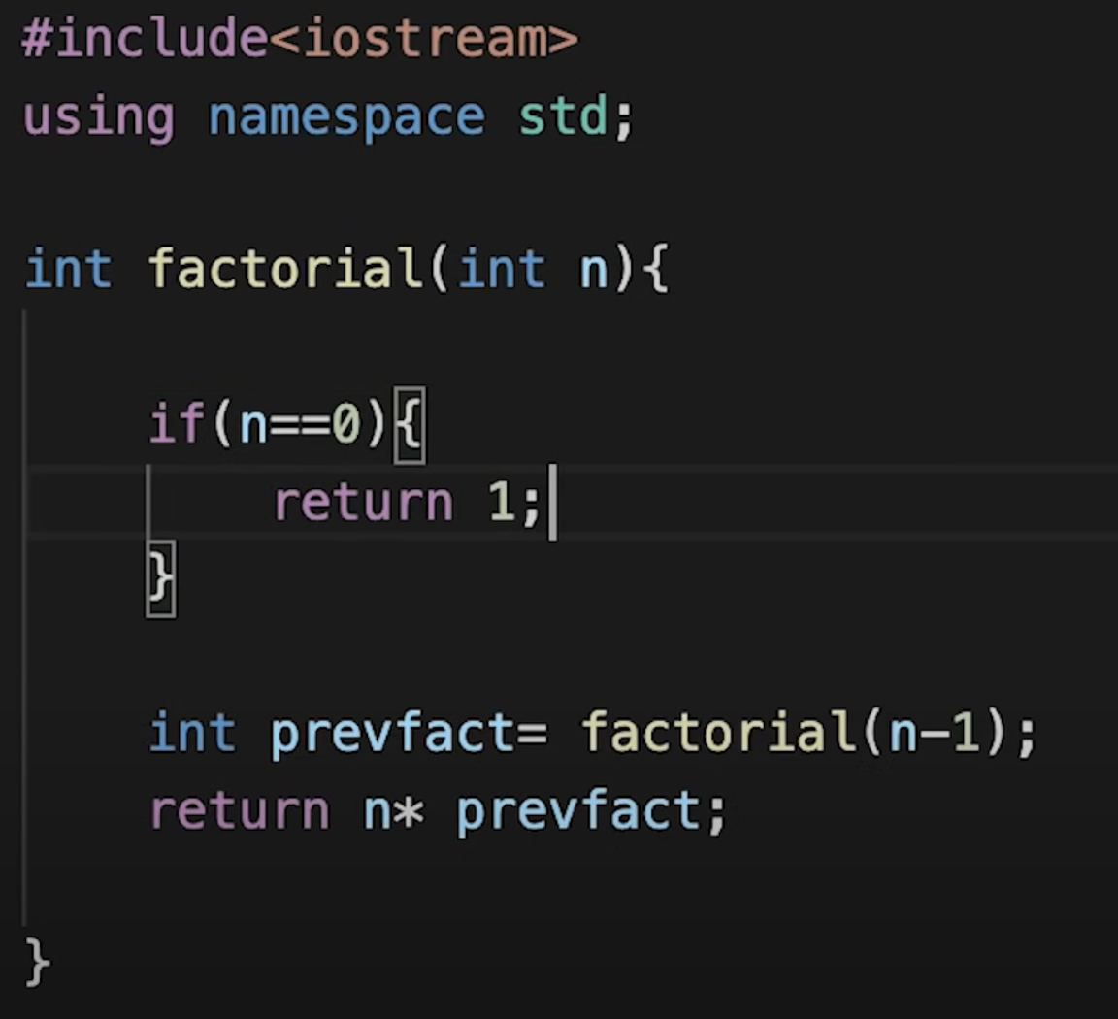
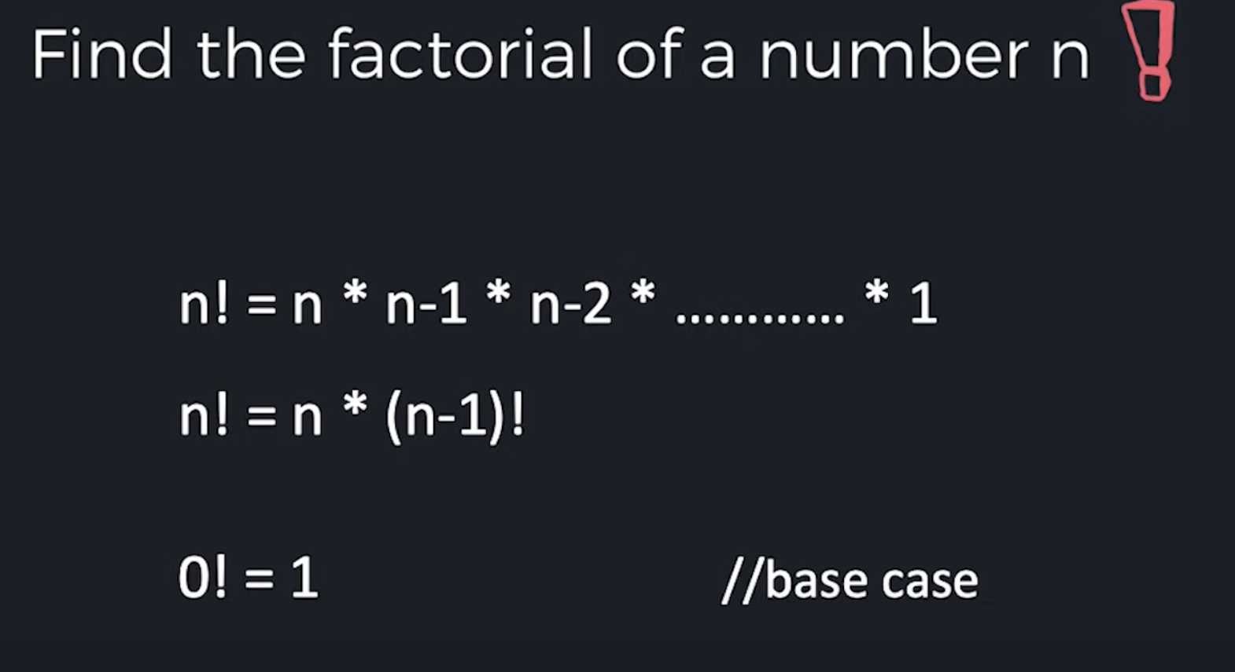

Slide 10
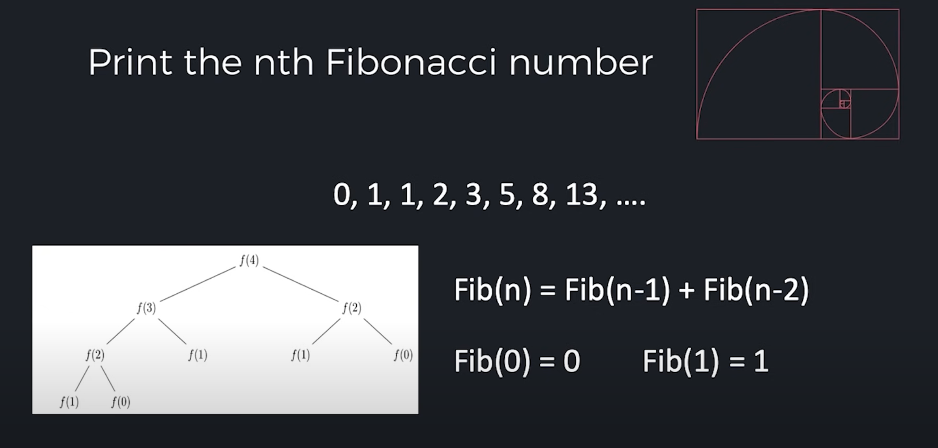
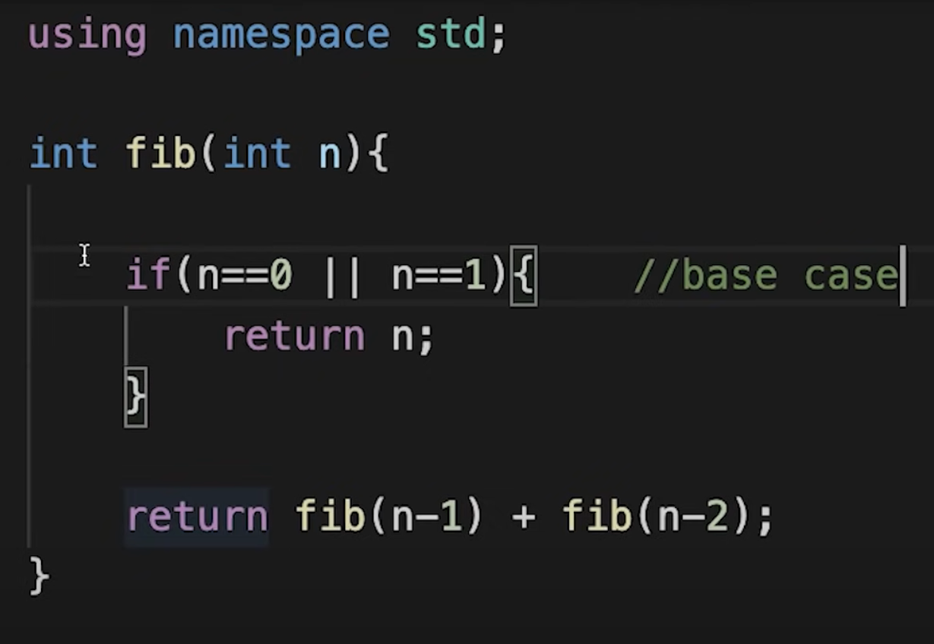

Slide 11
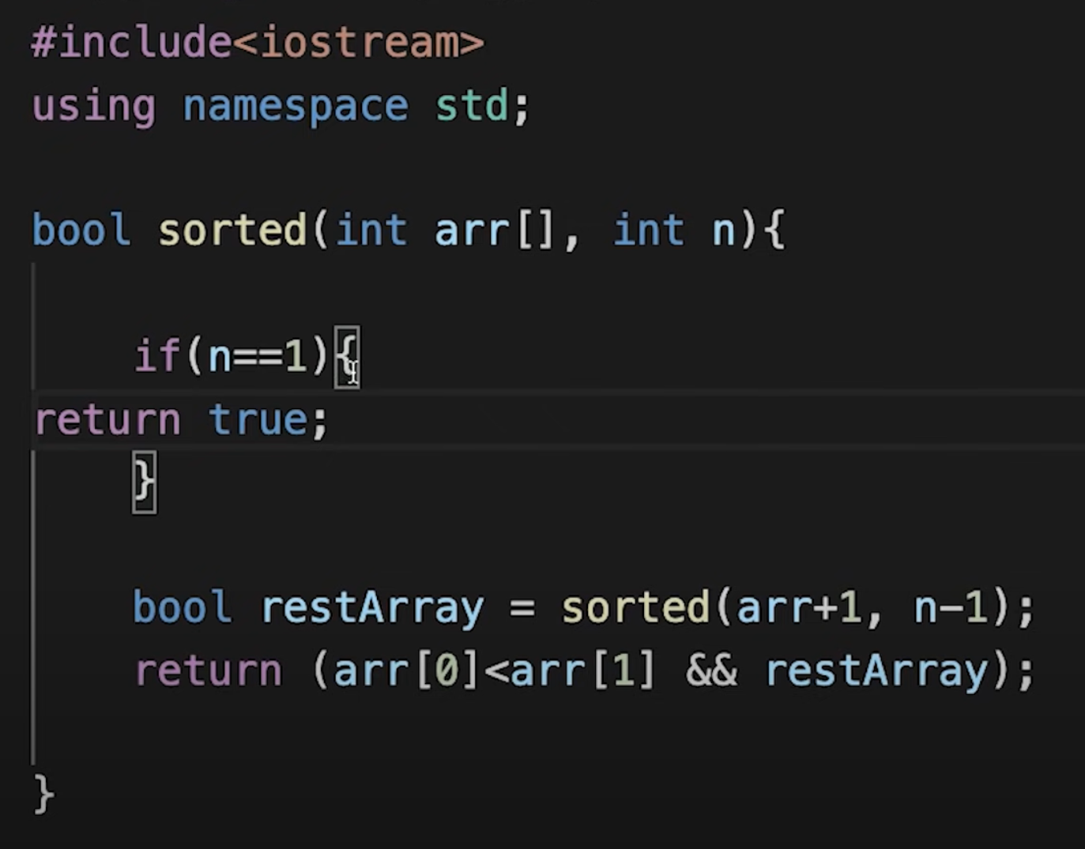
Given array is sorted or not

Slide 12
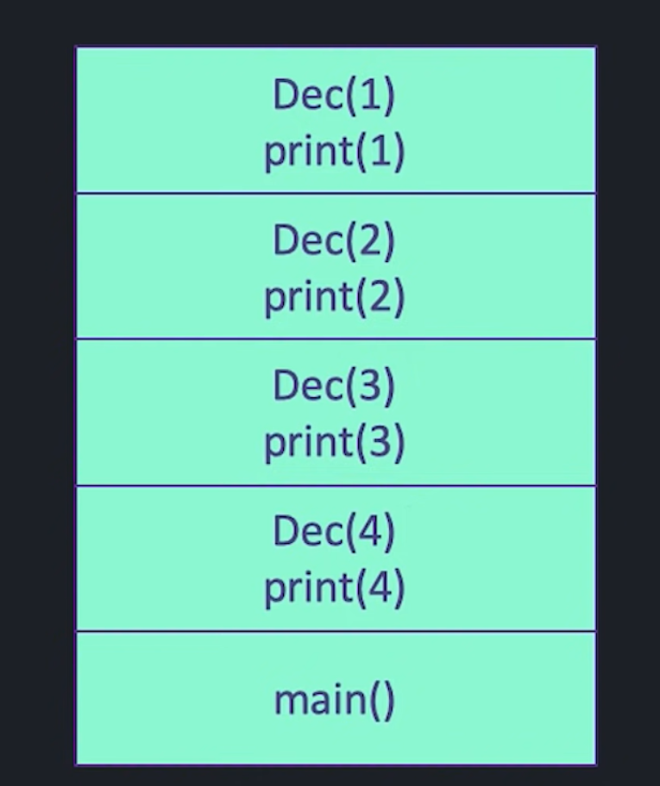
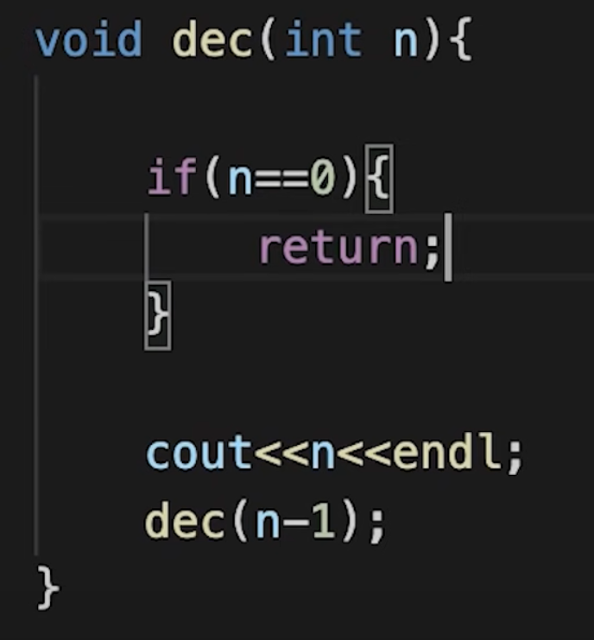
Print numbers till n..
Decreasing order

Slide 13
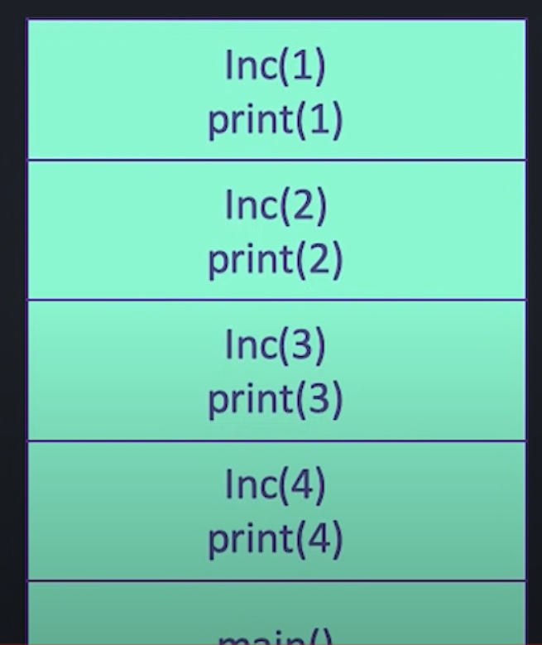
Increasing order

Slide 14
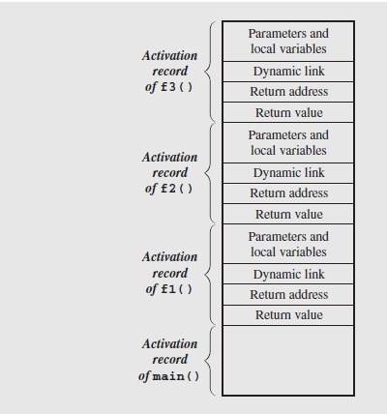
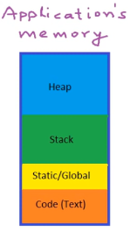
Stack Frame View
Contents of the run-time stack when main() calls function f1(), f1()
calls f2(), and
f2() calls f3().
Notes:
Because the stack may contain more than just frames (e.g., function return values or registers saved across calls), it is common to save the caller’s frame pointer as part of the callee’s control information. Each frame points to its caller’s frame on the stack. This pointer is called a dynamic link because it links a frame to its dynamic (runtime) predecessor.

Slide 15
Stack Frames are an implementation of Activation Records. The dynamic link tells you which activation record to return to when the current function is finished.

Slide 16

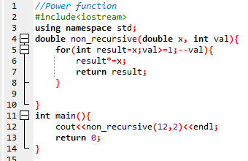
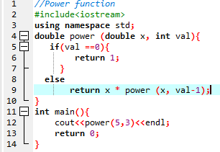

Recursive Function
A power function is defined in term of recursive definition and non recursive.

Slide 17
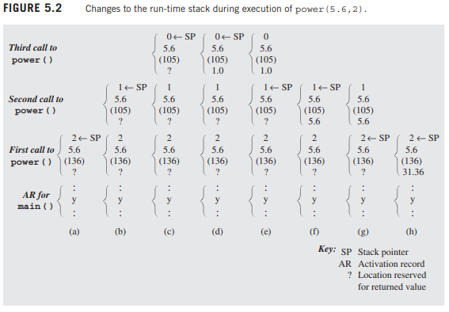
Stack frame in-depth view

